Slide 1
Efficiency and Bus Fleet Management: Strategic Communications and quantifying GHG and other co-benefits (#BBUS)
Case Application - Amritsar (M1, M2& M3 model)
July 2026
© Council on Energy, Environment and Water, 2026

Slide 2

Impacting sustainable development at scale with data, integrated analysis, and strategic outreach
TRANSFORMATIONS
QUALITY OF LIFE
ENABLERS
390+
Multidisciplinary team
550+
Peer-reviewed publications
700+
Convenings
400 million+
Lives impacted
11
Union ministries supported
20+
State governments supported
Low-carbon Economy
Clean Air
Sustainable Finance
Energy Transitions
Sustainable Water
Technology Futures
Power Markets
Sustainable Food Systems
Circular Economy
Industrial Sustainability
Sustainable Cooling
Climate Resilience
Sustainable Livelihoods
Sustainable Mobility
International Cooperation
SPECIAL INITIATIVES
CEEW Green Finance Centre
Powering Livelihoods
Emerging Economies
UP State Office

Slide 3
M1-Socio economic co-benefit
Premise for the analysis
>> Using Amritsar OD survey conducted on September,2025 we did a Difference in Difference analysis for monthly travel expenditure.
>> There were a total of 705 respondents from 36 different survey locations scattered across the city.
>> for the analysis we made the following assumptions.
Income wasn’t part of the survey so imputed it from PLFS 2025 based on profession.
Used low ambition modal shift randomly assigned to survey respondents to make a pseudo longitudinal data.

Slide 4




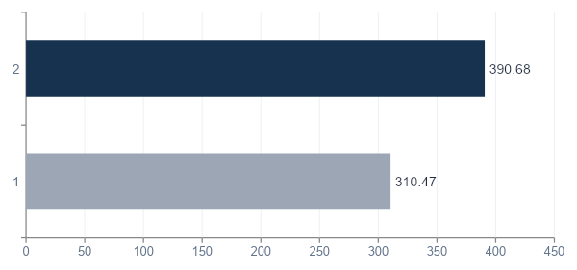
Pre-Treatment
The baseline
705
36
88
617
Sample size
treated obs.
comparison obs.
survey locations
across Amritsar
Pre-Treatment transport expenditure
What the baseline tells us ?
Before any bus service, treated individuals already spent about ₹80/month more on transport than control group.
This gap is exactly why we use DiD rather than a simple before/after comparison — the two groups were never identical to start with.
Treated and control groups have near-identical average vulnerability (VI ≈ 0.34 both), so the groups are comparable on this dimension.

Slide 5
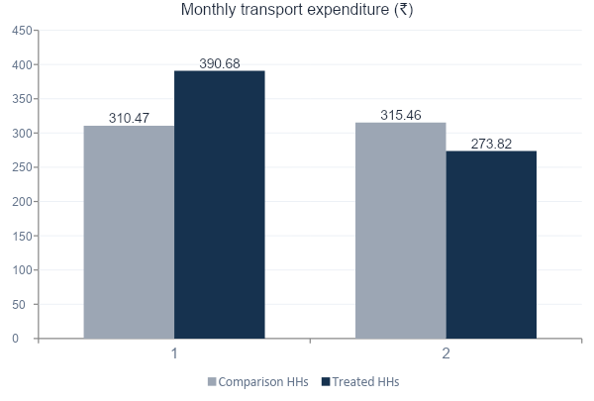
Post-Treatment
Transport spending fell for treated individuals
-₹122
On average the individuals with bus access have a 122INR decline in monthly transport expenditure. This is the DID-ATT after controlling for time and location fixed effects.
Statistically significant: p < 0.001 (cluster-robust SE by location)
Comparison group: essentially flat (+₹5, +1.6%) — the fall isn't just a citywide trend
Treated group: spending fell ~30%, from ₹391 to ₹274 — consistent with households substituting toward lower-cost bus trips
Link to google colab: https://colab.research.google.com/drive/1IuqGo55BqcTKaHaY95NbHHXM66iIrTBt?usp=sharing

Slide 6
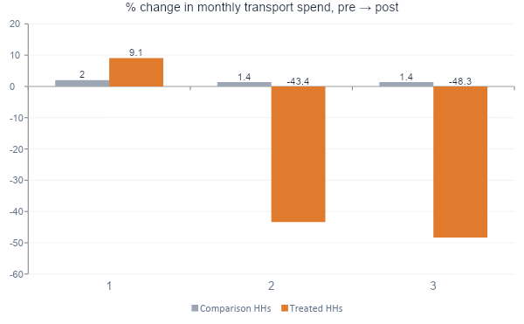
The Equity lens
Who benefits?
Savings are concentrated among vulnerable individuals
Low-vulnerability treated individuals track the control group — a small rise, no bus effect. They already own vehicles or have alternatives, so bus access doesn't change their spending.
Mid- and high-vulnerability treated individuals cut spending by 43–48% — the group most likely to switch onto the new bus service.
From the regression results the average saving of an individual with VI=1 is estimated to be 333 INR.
Low VI
Mid VI
High VI

Slide 7
Policy implications
Limitations
>> sequence future routes and stop planning through areas with large concentration of VRU’s as the analysis suggests they are the one who will reap maximum benefits.
>> Feeder services or better walking infrastructure to shift more people into the route buffer.
>> Frame fares around affordability- targeted fare subsidies for high VI individuals.
>> this data is purely artificial the results should be interpreted keeping that in mind. In the original data we might get counter intuitive or even statistically insignificant results.
>>the control variables i used are sparse(time fixed effects and location fixed effects). For more robust estimation we need rich controls and a large sample.
>>parallel trends assumption not tested. For testing we need at least 2 period pre-treatment data.

Slide 8
Regression results
I ran two separate specifications one to get the heterogeneous treatment(equity) effect and one to verify the average treatment(no equity) effect. Both were run with only time and location fixed effects as controls. The results are given along with their p-values.
With VI
Without VI
term | coef. | p_values
intercept | 215.62 | <0.001
treated | 78.28 | 0.012
DID | -8.08 | 0.854
VI*DID | -333.16 | <0.001
VI | 140.6 | 0.027
term | coef. | p_values
Intercept | 262.35 | <0.001
Treated | 79.00 | 0.011
DiD (ATT) | −121.85 | <0.001

Slide 9
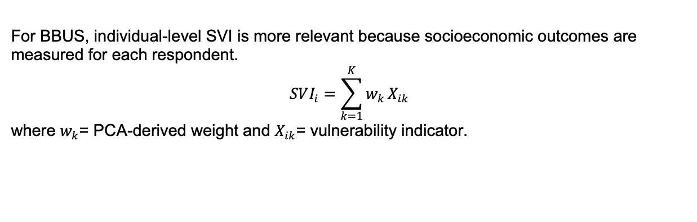
SVI(VI) – Social Vulnerability Index
Ward-level SVI | Individual-level SVI – BBUS
One SVI for each ward/area | One SVI for each survey respondent
Uses aggregated area characteristics | Uses individual/household characteristics
Used by Sharma & Patil (2021) | Proposed adaptation for BBUS
Identifies vulnerable areas | Identifies vulnerable individuals
For BBUS, individual-level SVI is more relevant because socioeconomic outcomes are measured for each respondent.
$$SVI_{i}=\sum_{k=1}^{K}{w_{k}}X_{ik}$$
where $w_{k}$= PCA-derived weight and $X_{ik}$= vulnerability indicator.
9|

Slide 10
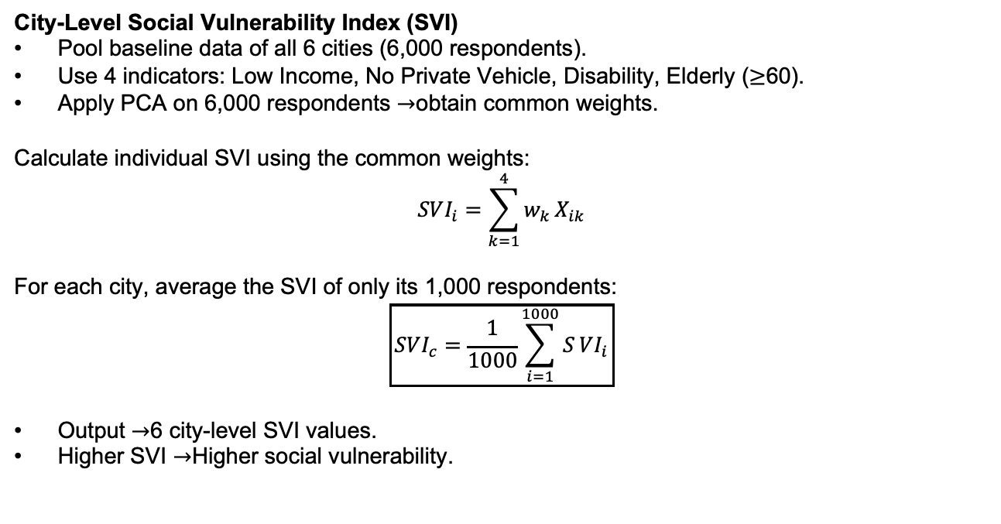
SVI(VI) – Social Vulnerability Index
City-Level Social Vulnerability Index (SVI)
Pool baseline data of all 6 cities (6,000 respondents).
Use 4 indicators: Low Income, No Private Vehicle, Disability, Elderly ($≥$60).
Apply PCA on 6,000 respondents $→$obtain common weights.
Calculate individual SVI using the common weights:
$$SVI_{i}=\sum_{k=1}^{4}{w_{k}}X_{ik}$$
For each city, average the SVI of only its 1,000 respondents:
$$\boxed{SVI_{c}=\frac{1}{1000}\sum_{i=1}^{1000}{S}VI_{i}}$$
Output $→$6 city-level SVI values.
Higher SVI $→$Higher social vulnerability.
10|

Slide 11
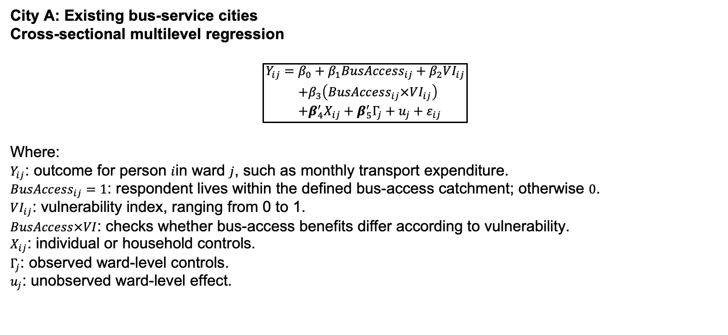
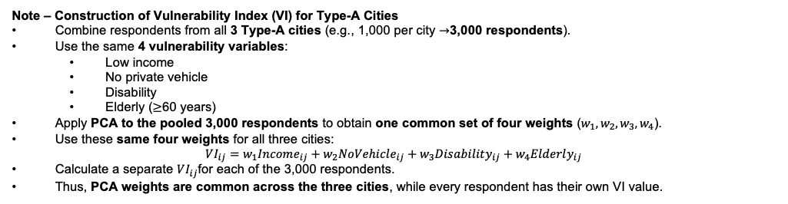
Expected Outputs from M1:City A
Note – Construction of Vulnerability Index (VI) for Type-A Cities
Combine respondents from all 3 Type-A cities (e.g., 1,000 per city $→$3,000 respondents).
Use the same 4 vulnerability variables:
Low income
No private vehicle
Disability
Elderly ($≥$60 years)
Apply PCA to the pooled 3,000 respondents to obtain one common set of four weights ($w_{1},w_{2},w_{3},w_{4}$).
Use these same four weights for all three cities:
$$VI_{ij}=w_{1}Income_{ij}+w_{2}NoVehicle_{ij}+w_{3}Disability_{ij}+w_{4}Elderly_{ij}$$
Calculate a separate $VI_{ij}$for each of the 3,000 respondents.
Thus, PCA weights are common across the three cities, while every respondent has their own VI value.
11|

Slide 12
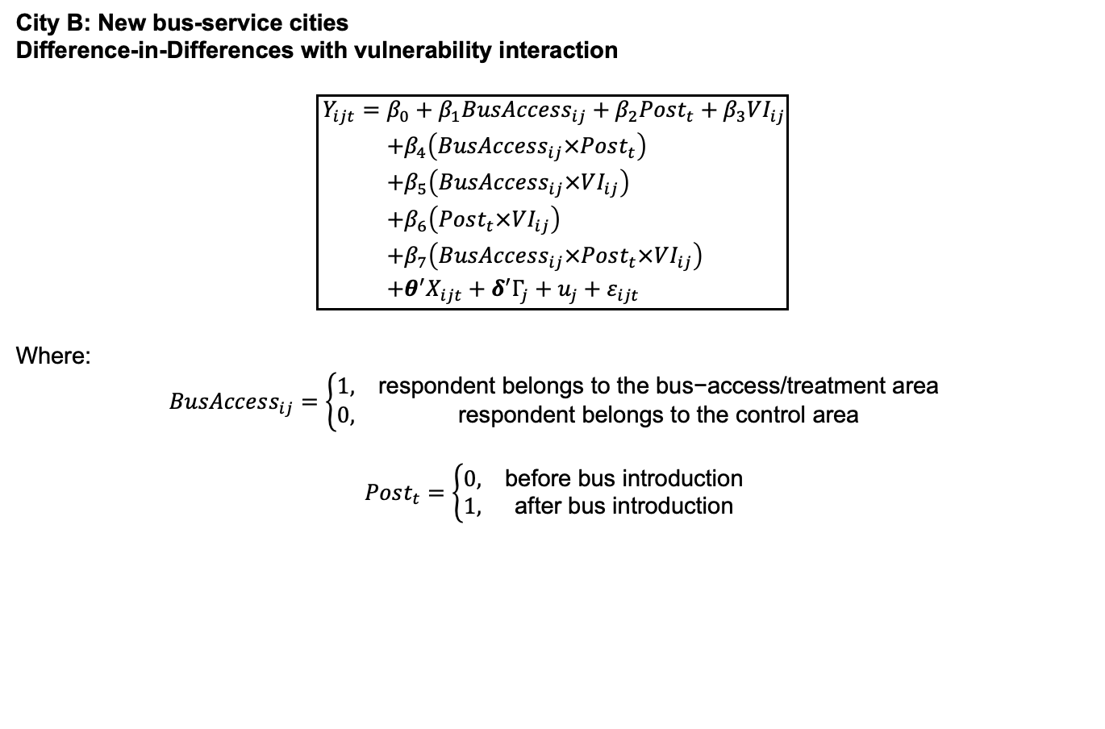
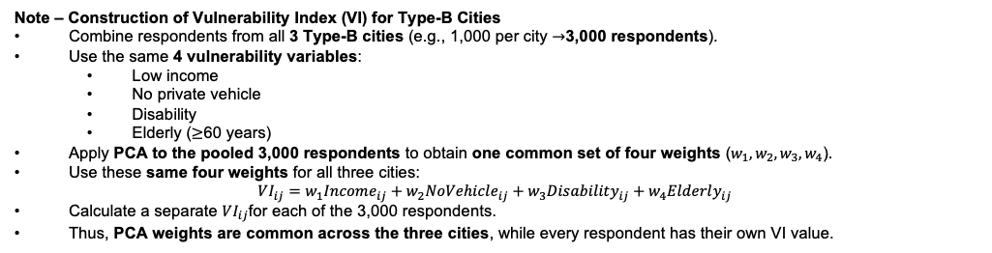
Expected Outputs from M2: City B
City B: New bus-service cities
Difference-in-Differences with vulnerability interaction
$$\boxed{\begin{aligned}Y_{ijt}=&β_{0}+β_{1}BusAccess_{ij}+β_{2}Post_{t}+β_{3}VI_{ij} \\ &+β_{4}\left(BusAccess_{ij}×Post_{t}\right) \\ &+β_{5}\left(BusAccess_{ij}×VI_{ij}\right) \\ &+β_{6}\left(Post_{t}×VI_{ij}\right) \\ &+β_{7}\left(BusAccess_{ij}×Post_{t}×VI_{ij}\right) \\ &+θ^{′}X_{ijt}+δ^{′}Γ_{j}+u_{j}+ε_{ijt}\end{aligned}}$$
Where:
$$BusAccess_{ij}=\left\{\begin{matrix}1, & \text{respondent belongs to the bus−access/treatment area} \\ 0, & \text{respondent belongs to the control area}\end{matrix}\right.$$
$$Post_{t}=\left\{\begin{matrix}0, & \text{before bus introduction} \\ 1, & \text{after bus introduction}\end{matrix}\right.$$
Note – Construction of Vulnerability Index (VI) for Type-B Cities
Combine respondents from all 3 Type-B cities (e.g., 1,000 per city $→$3,000 respondents).
Use the same 4 vulnerability variables:
Low income
No private vehicle
Disability
Elderly ($≥$60 years)
Apply PCA to the pooled 3,000 respondents to obtain one common set of four weights ($w_{1},w_{2},w_{3},w_{4}$).
Use these same four weights for all three cities:
$$VI_{ij}=w_{1}Income_{ij}+w_{2}NoVehicle_{ij}+w_{3}Disability_{ij}+w_{4}Elderly_{ij}$$
Calculate a separate $VI_{ij}$for each of the 3,000 respondents.
Thus, PCA weights are common across the three cities, while every respondent has their own VI value.
12|

Slide 13
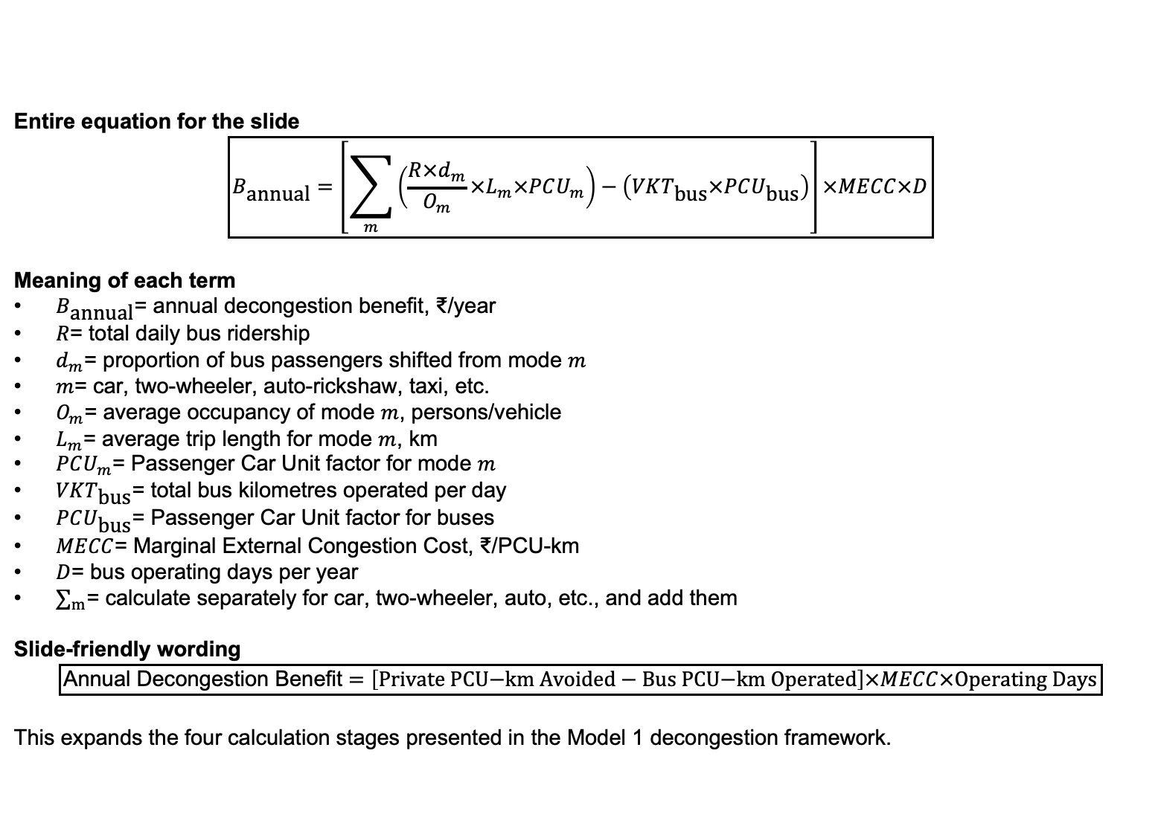
Expected Outputs from M1:
Entire equation for the slide
$$\boxed{B_{\text{annual}}=\left[\sum_{m}{\left(\frac{R×d_{m}}{O_{m}}×L_{m}×PCU_{m}\right)}−\left(VKT_{\text{bus}}×PCU_{\text{bus}}\right)\right]×MECC×D}$$
Meaning of each term
$B_{\text{annual}}$= annual decongestion benefit, ₹/year
$R$= total daily bus ridership
$d_{m}$= proportion of bus passengers shifted from mode $m$
$m$= car, two-wheeler, auto-rickshaw, taxi, etc.
$O_{m}$= average occupancy of mode $m$, persons/vehicle
$L_{m}$= average trip length for mode $m$, km
$PCU_{m}$= Passenger Car Unit factor for mode $m$
$VKT_{\text{bus}}$= total bus kilometres operated per day
$PCU_{\text{bus}}$= Passenger Car Unit factor for buses
$MECC$= Marginal External Congestion Cost, ₹/PCU-km
$D$= bus operating days per year
$∑_{m}$= calculate separately for car, two-wheeler, auto, etc., and add them
Slide-friendly wording
$$\boxed{\text{Annual Decongestion Benefit}=\left[\text{Private PCU−km Avoided}−\text{Bus PCU−km Operated}\right]×MECC×\text{Operating Days}}$$
This expands the four calculation stages presented in the Model 1 decongestion framework.
13|

Slide 14
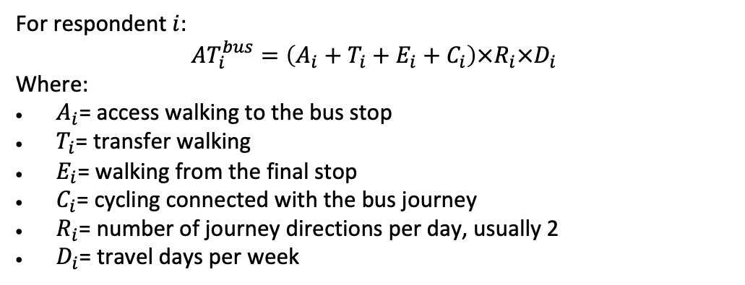
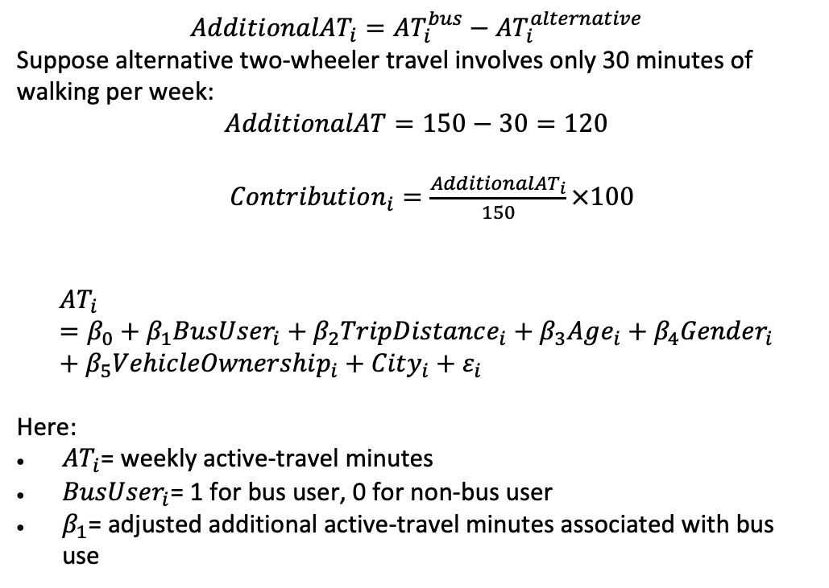
Expected Outputs from M2: Active Travel
14|

Slide 15
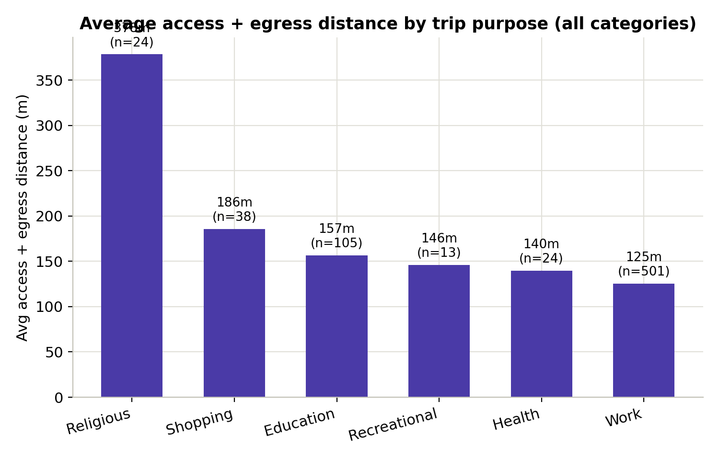

Slide 16
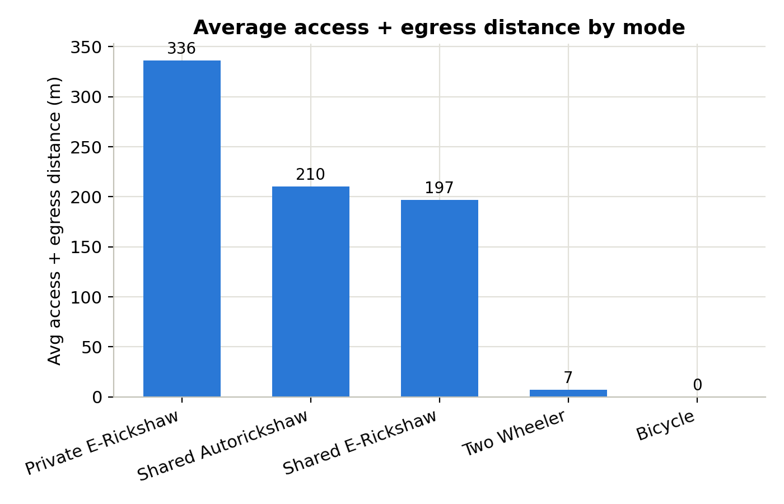

Slide 17
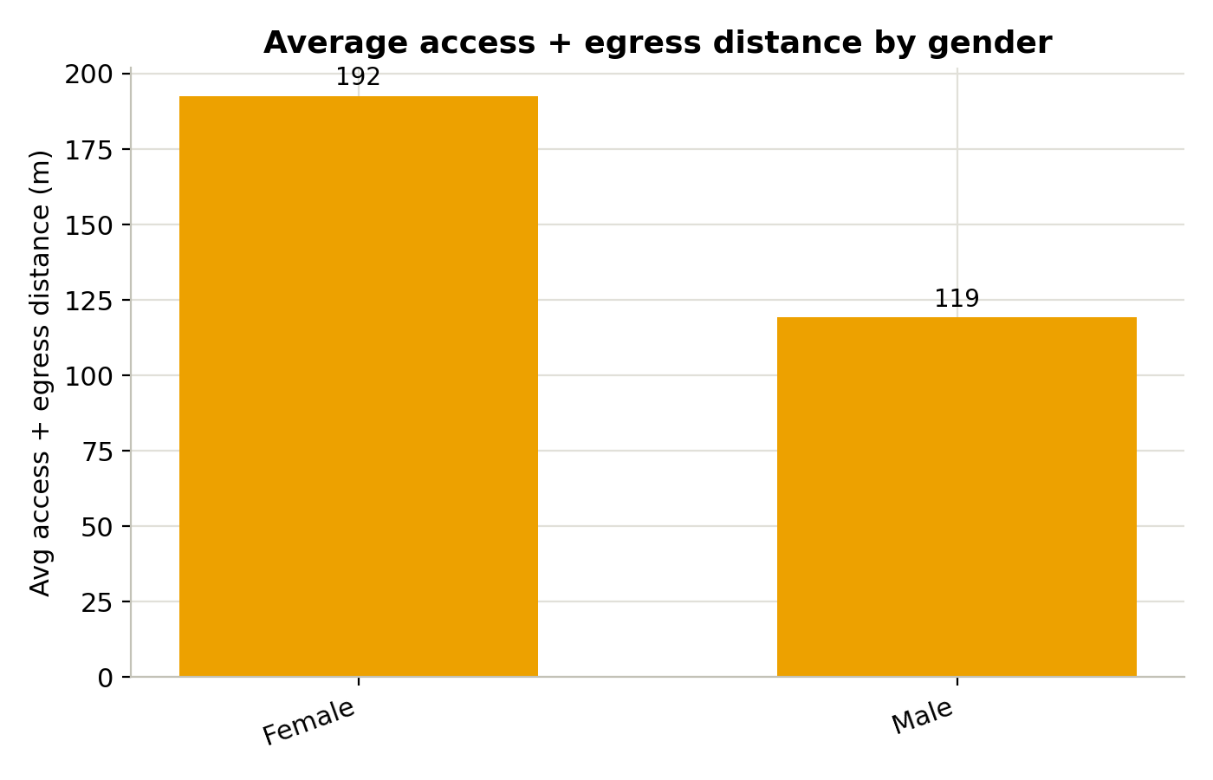

Slide 18
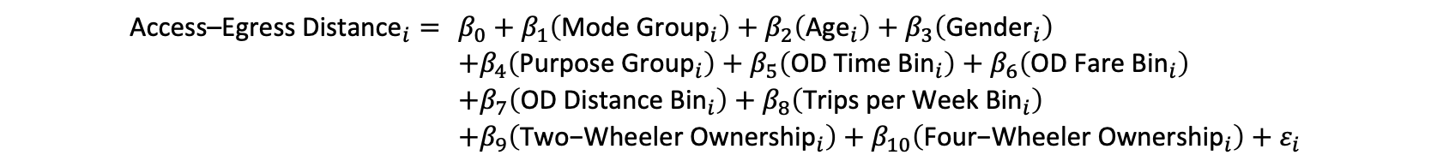
Expected Outputs from M2: Active Travel
18|

Slide 19
Expected Outputs from M2: Active Travel
Variable | Variable category | Base/reference category | Coefficient (metres) | p-value
Mode: Rickshaw | Binary | Two Wheeler | +179.02 | <0.001
Age | Continuous | Not applicable; one-year increase | −1.31 | 0.092
Gender: Male | Binary | Female | −0.31 | 0.990
Purpose: Work | Binary | Other purpose | −1.14 | 0.965
OD time: Short | Binary | Long: >10 min | +8.25 | 0.744
OD fare: Low | Binary | High: >₹10 | −32.32 | 0.317
OD distance: Short | Binary | Long: >5 km | −22.79 | 0.328
Weekly trips: High | Binary | Low: <5 trips/week | −51.64 | 0.031
Two-wheeler ownership: Yes | Binary | No two-wheeler owned | +43.72 | 0.089
Four-wheeler ownership: Yes | Binary | No four-wheeler owned | +24.72 | 0.351
Constant | — | Respondent belonging to all base categories, with age = 0 | 91.14 | 0.120
19|

Slide 20
Expected Outputs from M2: Assumption for bus deployment
30% of Two Wheeler riders shift to bus (fixed %, not data-driven)
50% of Rickshaw riders shift to bus (fixed %, not data-driven)
Who shifts is chosen randomly, not by likelihood of switching
All shifted riders assigned the same bus access/egress distance: 177.8m (average of shifted riders' old-mode distance)
Bus fare assigned via fixed distance-based slab table, not actual fare paid
Non-shifted riders keep their real, unchanged access/egress and fare values
20|

Slide 21
Expected Outputs from M2: AFTER Bus Deployment model results
Variable | Variable category | Base/reference category | Coefficient (metres) | p-value
Mode: Rickshaw | Binary | Two Wheeler | +180.78 | <0.001
Mode: Bus | Binary | Two Wheeler | +165.29 | <0.001
Age | Continuous | Not applicable; one-year increase | −1.13 | 0.033
Gender: Male | Binary | Female | +2.49 | 0.881
Purpose: Work | Binary | Other purpose | −14.01 | 0.423
OD time: Short | Binary | Long: >10 min | +4.08 | 0.809
OD fare: Low | Binary | High: >₹10 | −10.33 | 0.637
OD distance: Short | Binary | Long: >5 km | −13.68 | 0.439
Weekly trips: High | Binary | Low: <5 trips/week | −48.47 | 0.003
Two-wheeler ownership: Yes | Binary | No two-wheeler owned | +19.40 | 0.259
Four-wheeler ownership: Yes | Binary | No four-wheeler owned | +9.50 | 0.596
21|

Slide 22
Expected Outputs from M2: Reduction in pollution
What the Mumbai commute study measured
A peer-reviewed foundation for the pollution & GHG co-benefit model
Purpose: Compare air-pollution exposure across common commute modes and estimate inhaled dose for commuters and road-based workers.
98
8.5 km
Design: 98 instrumented trips on a fixed 8.5 km Mumbai route across morning, afternoon, and evening periods, paired with an 800-person household survey.
instrumented trips
fixed Mumbai route
3
800
MODES STUDIED
daily traffic periods
survey participants
Bus
Car
Auto-rickshaw
Motorbike
Key idea: exposure is not concentration alone - it also depends on time spent inside that mode.
Suburban train
Pollutants covered: PM₁ • PM₂.₅ • PM₁₀ • CO • TVOC
22|

Slide 23
Expected Outputs from M2: Reduction in pollution
Main pollution-exposure findings
Which mode drives which pollutant — and why bus riders still lose out
Auto-rickshaw
Car
Motorbike
Suburban train
Highest particle number; high PM₂.₅ and PM₁₀
Highest TVOC concentration
Highest CO concentration
Lowest overall exposure among studied modes
Why the bus result matters: buses had lower pollutant concentrations than most road modes, but bus users still accumulated a high inhaled dose - trips ran ~1.2x longer due to congestion and slower speeds.
EXPOSURE SHARE BY GROUP
Office commuters: ~25–30% of daily dose occurs during work-related travel. Road-based workers: ~90% of daily dose occurs during work hours.
23|

Slide 24
Expected Outputs from M2: Reduction in pollution
Turning the paper into a pollution-reduction output
Use for personal exposure reduction, not city-wide emissions directly
CORE DOSE EQUATION
BEFORE (prior mode)
EXPOSURE BENEFIT
D = C × IR × t
C_previous × IR × t_previous
D_before − D_after
D = inhaled dose
C = in-mode concentration
IR = inhalation rate
t = travel time
AFTER (bus)
Reduction in inhaled pollutant mass attributable to switching onto the bus.
C_bus × IR × t_bus
Survey data needed: previous mode • current bus use • travel time • trip distance • days/week • full/partial mode replacement
Final output: annual reduction in inhaled PM₂.₅, PM₁₀ or CO per respondent, aggregated across the sample and scaled to the city.
24|

Slide 25
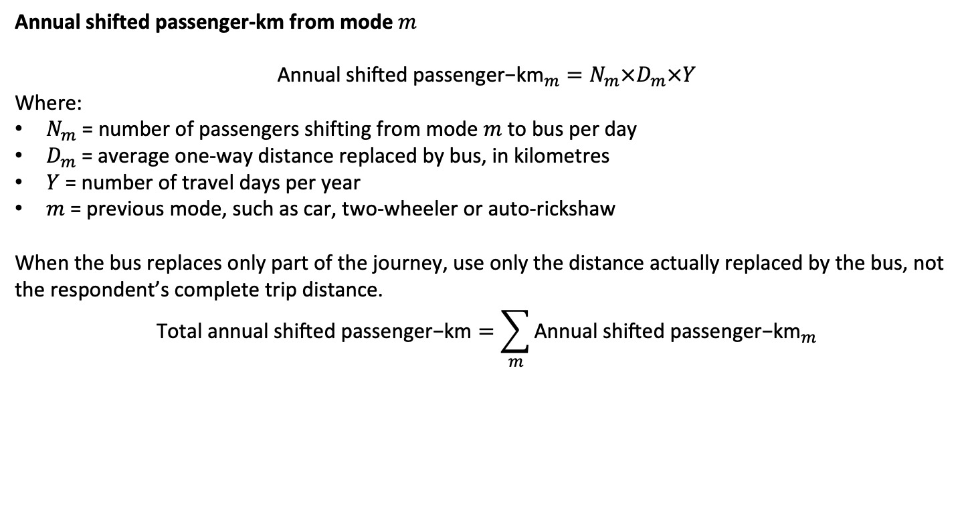
Expected Outputs from M2: Reduction in Fatalities
City B: buses will be introduced
What mode do you currently use?
What is your one-way trip distance?
How many days per week do you make this trip?
Would you use the proposed bus service?
Which current mode would the bus replace?
Would it replace the full trip or only part of it?
How many days per week would you use the bus?
How would you reach and leave the bus stop?
City A: buses already operating
What is your one-way bus-trip distance?
How many days per week do you use the bus?
If this bus were unavailable, which mode would you use?
Before using the bus, which mode did you normally use?
Does the bus replace the full trip or only part of it?
How do you reach and leave the bus stop, and what is the distance?
25|

Slide 26
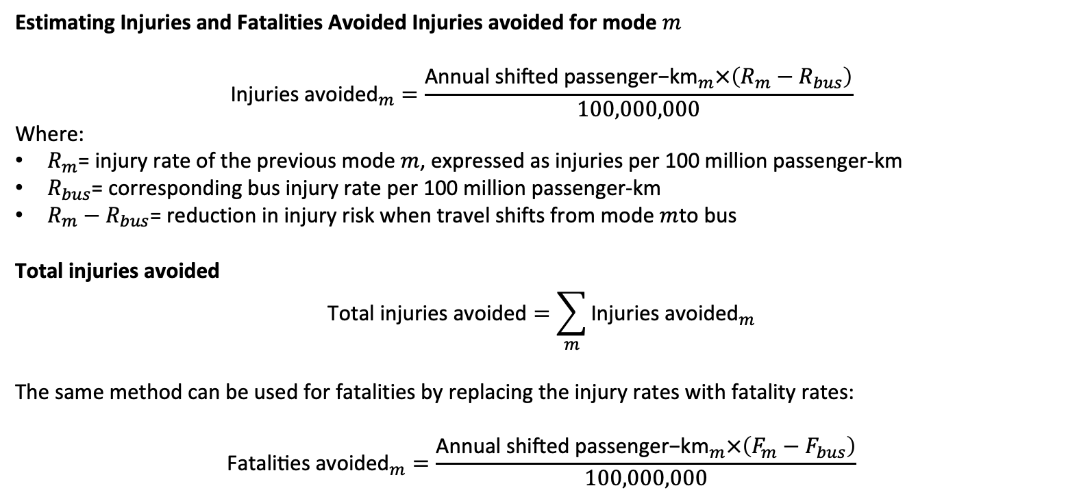
Expected Outputs from M2: Reduction in Fatalities
26|

Slide 27
Expected Outputs from M2: Reduction in Fatalities
27|

Slide 28
Expected Outputs from M1:City A
28|

Slide 29
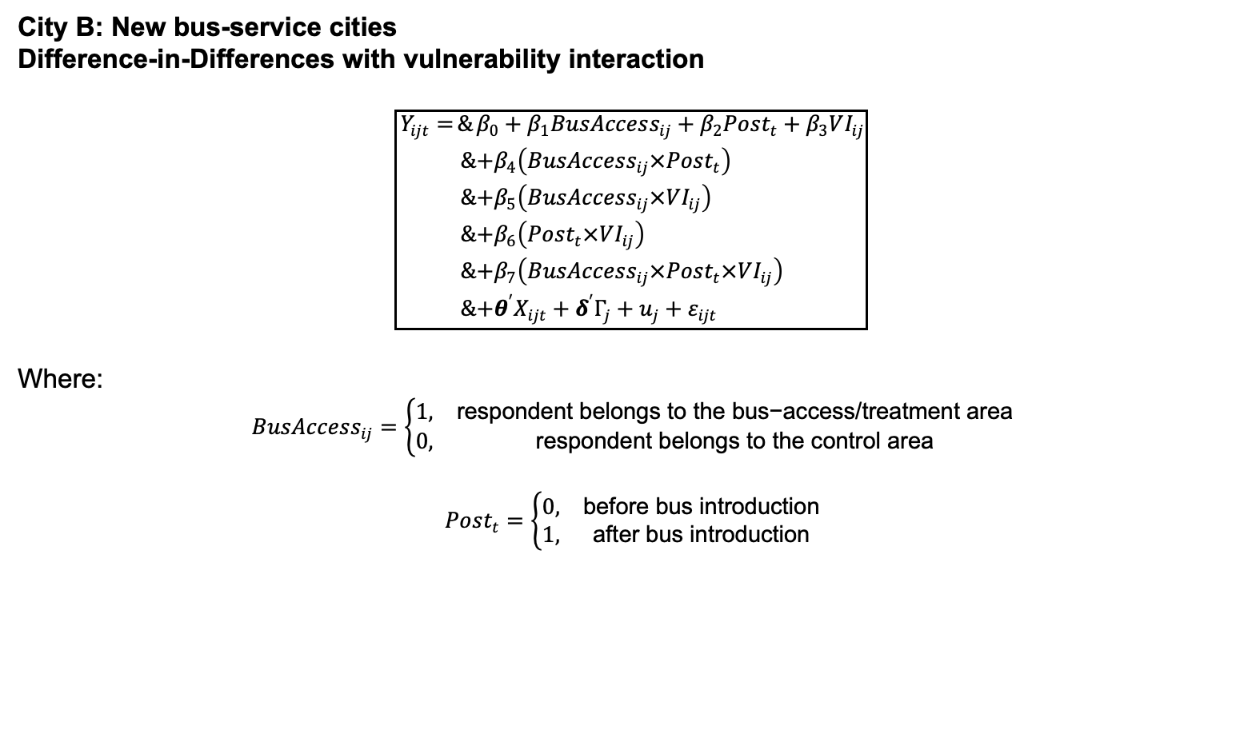
Expected Outputs from M2: City B
29|

Slide 30
Expected Outputs from M1:
Entire equation for the slide
$$\boxed{B_{\text{annual}}=\left[\sum_{m}{\left(\frac{R×d_{m}}{O_{m}}×L_{m}×PCU_{m}\right)}−\left(VKT_{\text{bus}}×PCU_{\text{bus}}\right)\right]×MECC×D}$$
Meaning of each term
$B_{\text{annual}}$= annual decongestion benefit, ₹/year
$R$= total daily bus ridership
$d_{m}$= proportion of bus passengers shifted from mode $m$
$m$= car, two-wheeler, auto-rickshaw, taxi, etc.
$O_{m}$= average occupancy of mode $m$, persons/vehicle
$L_{m}$= average trip length for mode $m$, km
$PCU_{m}$= Passenger Car Unit factor for mode $m$
$VKT_{\text{bus}}$= total bus kilometres operated per day
$PCU_{\text{bus}}$= Passenger Car Unit factor for buses
$MECC$= Marginal External Congestion Cost, ₹/PCU-km
$D$= bus operating days per year
$∑_{m}$= calculate separately for car, two-wheeler, auto, etc., and add them
Slide-friendly wording
$$\boxed{\text{Annual Decongestion Benefit}=\left[\text{Private PCU−km Avoided}−\text{Bus PCU−km Operated}\right]×MECC×\text{Operating Days}}$$
This expands the four calculation stages presented in the Model 1 decongestion framework.
30|

Slide 31
Model M3- GHG mitigation + Pollution (PM 2.5, PM10 and NOx) calculation
Assumption
Population of Amritsar City, 2025 = 1.69 million (Estimated)
Estimated Number of motorized vehicles, 2025
Future Scenario development
53 State carriage permit Private buses (ICE) . Public transport depends on Auto rickshaws (ICE +EV) and E-rickshaws .
Low Ambition | 93 Metro Buses / BRT buses deployed | ALL ICE
Moderate Ambition | 93 BRT buses + 40 PM e-bus | BRT-ICE + PM e-Bus- EV
High Ambition | 93 BRT buses + 100 PM e-Bus | BRT-ICE + PM e-Bus- EV
Vehicles | Number (2025) | Remarks | Sources
Auto rickshaws (ICE) | 25500 | 2025 news article shows total number of auto rickshaws and E rickshaws = 85000
Auto rickshaws (EV) | 39350 | ICE= 30% and EV = 70% e-Auto rickshaws = 58.4% and e-rickshaws = 41.5% (Primary Survey)
E- rickshaws | 20000
2W | 313205 | 185 two wheelers per 1000 people
Car | 57562 | 34 cars per 1000 people (Regional assumption on 2022)
Private Buses | 53 | Punjab state government sanctioned State carriage permit of 53 private ICE buses
Justification -
BRT operation in 2015 planned for 93 buses and operation stopped on 2023.
Assuming full capacity implementation in low ambition and PM e-Bus sewa Amritsar has sanctioned for 100e-buses .

Slide 32
Model M3- GHG mitigation + Pollution (PM 2.5, PM10 and NOx) calculation
Activity Parameter- VKT calculation
Assumption | Vehicle category | Option 1- | Option 2- |  |  | Total number of vehicle | Option 1 | Option 2 | Vehicle Characteristics
 |  | Daily Utilisation (Km) | Number of trips | Average trip length | Daily utilisation (Km) |  | VKT (Km) | VKT (Km)
Primary survey | Auto rickshaws (ICE) | 120 | 8 | 13 | 106 | 25500 | 2691759 | 3060000
 | E-rickshaws | 90 | 12 | 5 | 64 | 20000 | 1282424 | 1800000
 | 2w | 30 | 4 | 6 | 23 | 313205 | 7201840 | 9396150
 | Auto rickshaws (EV) | 120 | 8 | 13 | 106 | 39350 | 4152212 | 4722000
Secondary Literature | Car | 40 | Nil |  | 40 | 57562 | 2302480 | 2302480
 | Metro Buses /BRT | 200 |  |  | 200 | 93 | 18600 | 18600
 | PM e-buses | 200 |  |  | 200 | 100 | 20000 | 20000
 | Pvt Buses | 350 |  |  | 350 | 51 | 17850 | 17850
Limitation - The 2025 EV–ICE split for two-wheelers and cars is unavailable in both the primary survey and secondary literature. Given the city's size and the expected low EV penetration, all 2Ws and 4Ws have been assumed to be ICE vehicles.

Slide 33
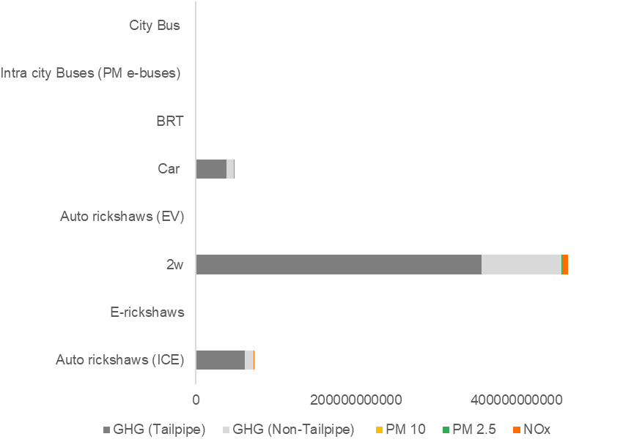
Model M3- GHG mitigation + Pollution (PM 2.5, PM10 and NOx) calculation
GHG and Pollutant emission calculation for different Vehicle categories-
Assumption - All 2W are Petrol , City bus and BRT buses Diesel fueled . BS IV and BS VI are 30% and 70% .
Vehicle Category | Fuel | Share
Auto rickshaws | Petrol | 7
 | Diesel | 31
 | CNG | 62
Car | Petrol | 58
 | Diesel | 30
 | CNG | 12
Vehicle Category | Fuel | GHG (Tailpipe) | GHG (Non-Tailpipe) | PM 10 | PM 2.5 | NOx
Auto rickshaws | Petrol | 3177379619 | 894067858 | 237326 | 213585 | 5894446
 | Diesel | 16325089593 | 4873161073 | 7912172 | 7121768 | 79964480
 | CNG | 41878727968 | 5177733640 | 18617952 | 16755547 | 462413240
2W | Petrol | 356506374263 | 100315646438 | 130833446 | 117750101 | 7914875661
Car | Petrol | 18015598191 | 5069324166 | 364526 | 326772 | 91346331
 | Diesel | 13513715616 | 4033944960 | 1673770 | 1505539 | 40386419
 | CNG | 6656009184 | 822924772 | 20870 | 18864 | 2368460
City Bus | Diesel | 349217400 | 104244000 | 2669 | 2403 | 117045
BRT | Diesel | 363890400 | 108624000 | 2898 | 2609 | 127087
E-rickshaws | EV | nil | 1724 | Bare minimum pollution from EV
Auto Rickshaws |  |  | 4871
PM eBus |  |  | 259
92% of NOx emissions from 2W
3,13,205 -2w on the road .

Slide 34
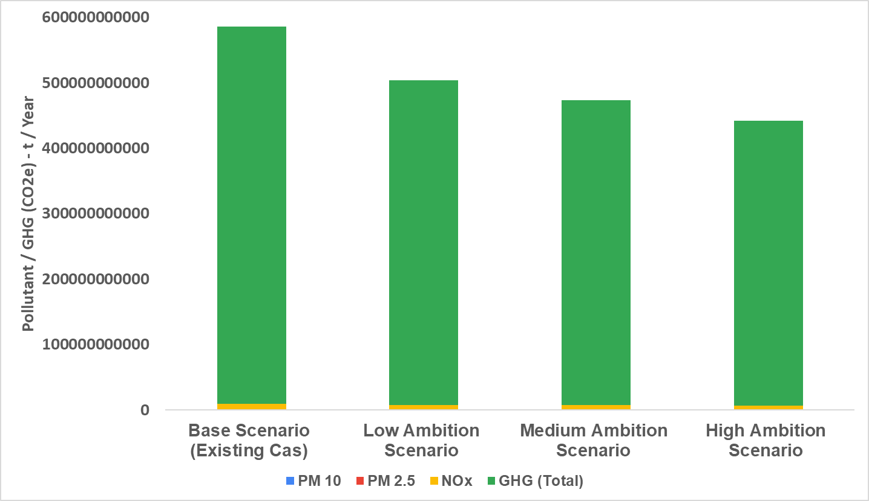
Model M3- GHG mitigation + Pollution (PM 2.5, PM10 and NOx) calculation
Existing / Baseline scenario Calculation
5.78
8,597
159.7
143.7
lakh tonnes
tonnes
tonnes
tonnes
GHG (CO₂e) / year
NOx / year
PM10 / year
PM2.5 / year
14 % reduction
Scenario | 2W shift | IPT shift | 4W shift | Bus
Low | 15% | 15% | 5% | 93 BRT diesel buses , 53 city diesel buses
Moderate | 20% | 20% | 10% | 93 BRT diesel buses & 40 PM e-BUses & 53 city diesel buses
High | 25% | 25% | 15% | 93 BRT diesel buses & 100 PM e-BUses & 53 city diesel buses
19 %
reduction
24 %
reduction

Slide 35
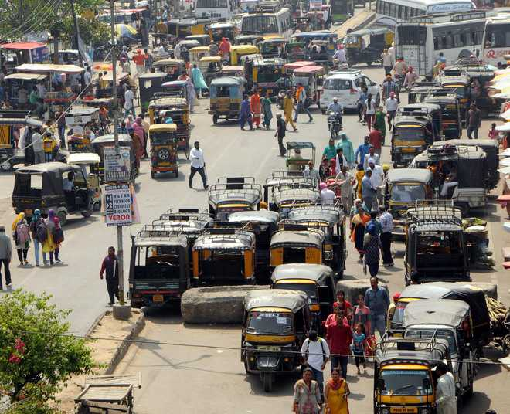
Inferences and Policy Implications
High Ambition Scenario: Based on existing state government vision and implementation plans.
Total e-buses: 246 projected under the high ambition scenario.
CMP norms | 55 buses / lakh | 930 buses
MoHUA | 60 buses / lakh | 1014 buses
Policy Implications -
Permit capping and route rationalization for auto rickshaws and e-rickshaws (example - Delhi, Kolkata )
Old Vehicle scrappage linked entry - new e-rickshaws permit only against scrappage of old ICE (BS IV) 3W scrappage
Dynamic parking pricing pairing with on street parking removal in commercial zone
Feeder e-rickshaws and e-auto rickshaws integration under a regulated aggregator model
NMT push : Cycle track and footpath integration

Slide 36
Thank you
ceew.in | @CEEWIndia

